Slide 1
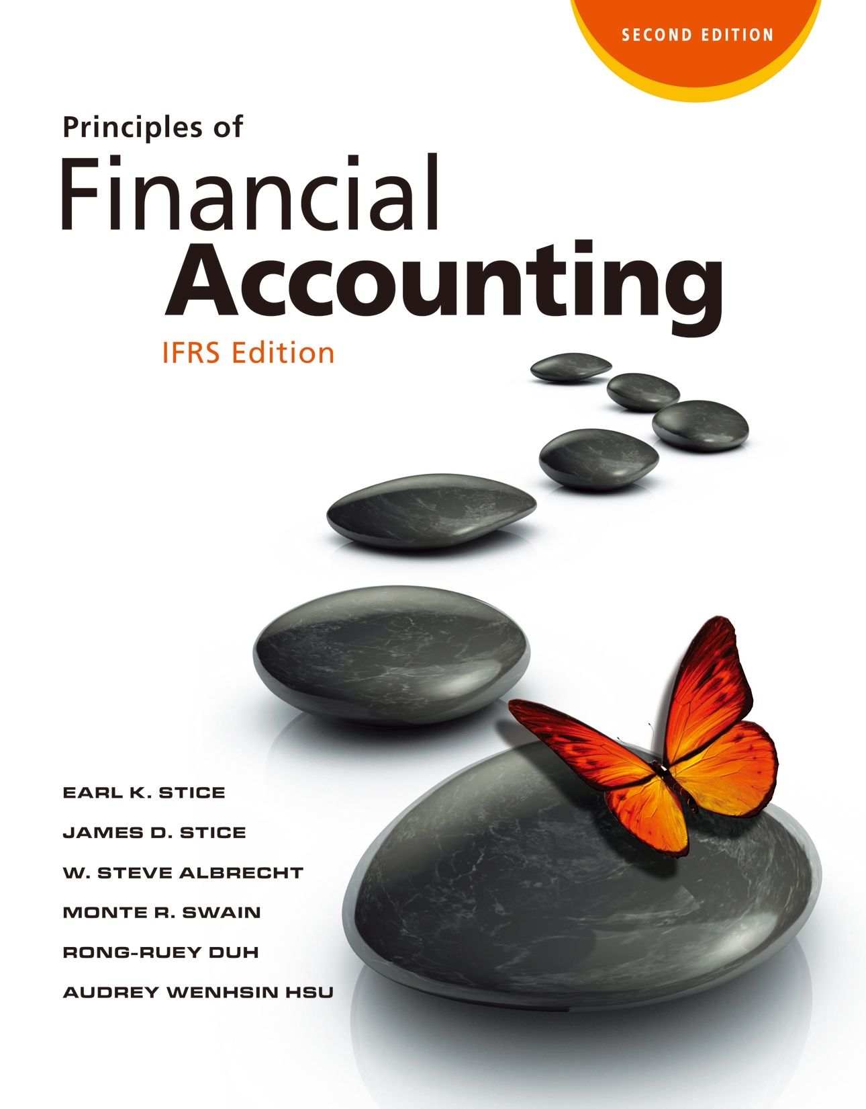

Slide 2
Financing: Long-Term Liabilities

Slide 3
Present Value and Future Value Concepts
Measuring Long-Term Liabilities
LO1
Present Value
The value today of $100 to be received or paid in the future, given a specified interest rate.
Present Value
(Computed)
$90.91
Future Amount
(Known)
$100
(One-Year Period @ 10%)
$90.91 is the present value of the $100 future amount.

Slide 4
Present Value and Future Value Concepts
LO1
Future Value
The value in the future of $100 to be received or paid today, given a specified interest rate.
Present Value
(Known)
$90.91
Future Amount
(Computed)
$100
(One-Year Period @ 10%)
$100 is the future value of the $90.91 present value.

Slide 5
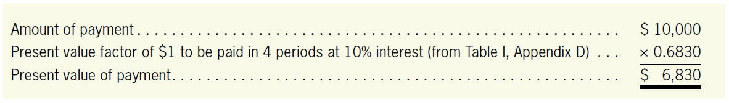
Present Value and Future Value Concepts
LO1
Computing the Present Value of a Single Amount
Assume that $10,000 is to be paid four years from today when the interest rate is 10%.
Present Value Table (Appendix D, Table Ⅰ)
Period | 7% | 8% | 9% | 10% | 12%
1 | 0.9346 | 0.9259 | 0.9174 | 0.9091 | 0.8929
2 | 0.8734 | 0.8573 | 0.8417 | 0.8264 | 0.7972
3 | 0.8163 | 0.7938 | 0.7722 | 0.7513 | 0.7118
4 | 0.7629 | 0.7350 | 0.7084 | 0.6830 | 0.6355

Slide 6
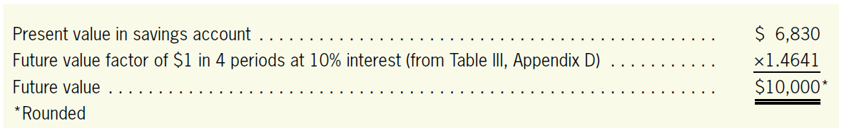
Present Value and Future Value Concepts
LO1
Computing the Future Value of a Single Amount
Assume that we have a savings account with a current balance of $6,830 that earns interest of 10%.
Future Value Table (Appendix D, Table Ⅲ)
Period | 7% | 8% | 9% | 10% | 12%
1 | 1.0700 | 1.0800 | 1.0900 | 1.1000 | 1.1200
2 | 1.1449 | 1.1664 | 1.1881 | 1.2100 | 1.2544
3 | 1.2250 | 1.2597 | 1.2950 | 1.3310 | 1.4049
4 | 1.3108 | 1.3605 | 1.4116 | 1.4641 | 1.5735

Slide 7
Present Value and Future Value Concepts
LO1
Compounding Period
The frequency with which interest is added to the principal.
E.g., interest of 10% has been compounded once a year (annual compounding period) to arrive at a future value at the end of four years of $10,000.
If the interest is added more or less frequently than once a year, the future amount will be different.

Slide 8
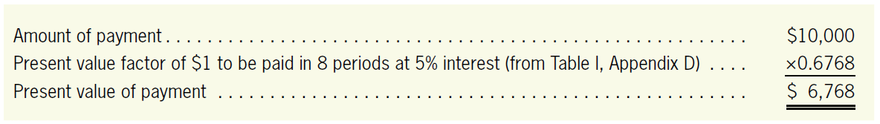
Present Value and Future Value Concepts
LO1
Compounding Period
Assume that the 10% interest had been compounded semiannually (twice a year) for four years.
What is the present value of $10,000 to be paid in four years if interest of 10% is compounded semiannually?
Rate: 10% → 5% (10% × ½)
Period: 4 years → 8 periods (4 × 2)

Slide 9
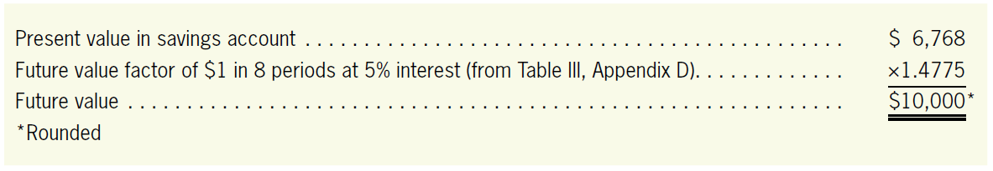
Present Value and Future Value Concepts
LO1
Compounding Period
Likewise, if semiannual compounding is used to determine the future value of $6,768 in four years at 10% compounded semiannually, the result is as follows:
Earn more interest than the annual compounding ($6,830) does.

Slide 10
Present Value and Future Value Concepts
LO1
Formula for Interest Rate
Formula For Number of Interest Periods
Yearly interest rate
Interest rate
per compounding period
=
Compounding periods per year
Compounding periods per year
Number of
interest periods
×
Number of years
=

Slide 11
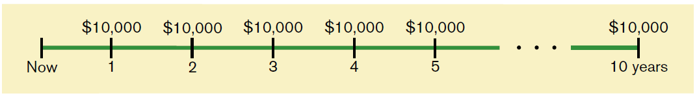
Computing the Present Value of an Annuity
LO1
Annuity is a series of equal amounts to be received or paid at the end of equal time periods
Assume that $10,000 is to be paid at the end of each of the next 10 years. This series of payments is illustrated below.

Slide 12
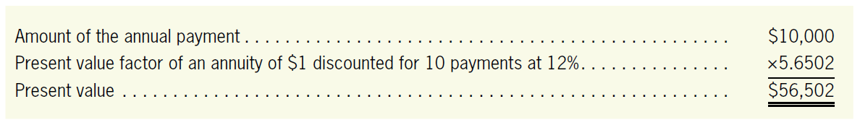
Computing the Present Value of an Annuity
LO1
If the interest rate is 12% compounded annually, the present value factor of 5.6502.
Present Value of an Annuity Table (Appendix D, Table Ⅱ)
Period | 7% | 8% | 9% | 10% | 12%
⋮ | ⋮ | ⋮ | ⋮ | ⋮ | ⋮
8 | 5.9713 | 5.7466 | 5.5348 | 5.3349 | 4.9776
9 | 6.5152 | 6.2469 | 5.9952 | 5.7590 | 5.3282
10 | 7.0236 | 6.7101 | 6.4177 | 6.1446 | 5.6502

Slide 13
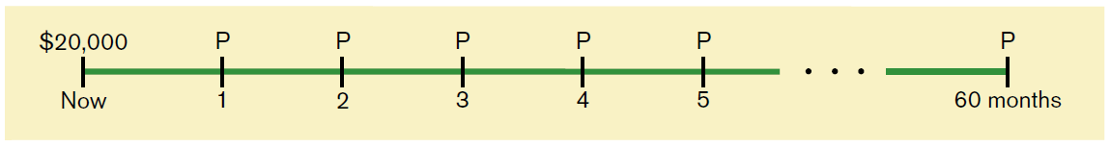
Computing the Present Value of an Annuity
LO1
Computing Periodic Payments
Assume a monthly payment on an automobile loan of $20,000 if the interest rate is 12% compounded monthly (i.e., 1% per month)
Loan period is 60 months.

Slide 14
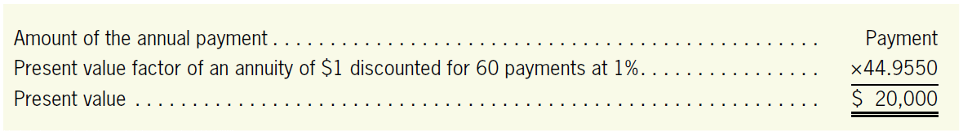
Computing the Present Value of an Annuity
LO1
Computing Periodic Payments
$20,000 = Payment × 44.9550
Payment = $20,000 / 44.9550
Payment = $444.89

Slide 15
Quiz Yourself
LO1
Compute the following values:
The present value of a single payment of $12,000 to be made five years from today at a 6% interest rate
FV = $12,000; I = 6%; N = 5 → PV = $8,967.6
The future value in five years of $2,000 invested today at a 4% interest rate
PV = $2,000; I = 4%; N = 5 → FV = $2,433.4

Slide 16
Quiz Yourself
LO1
The present value of 10 equal annual payments of $500 at an 8% interest rate
PMT = $500; I = 8%; N = 10 → PV = $3,355.05
The payment associated with a loan of $20,000 to be repaid with equal monthly payments over a five-year period at an interest rate of 12% compounded monthly
PV = $20,000; I = 1%; N = 60 → PMT = $444.89

Slide 17
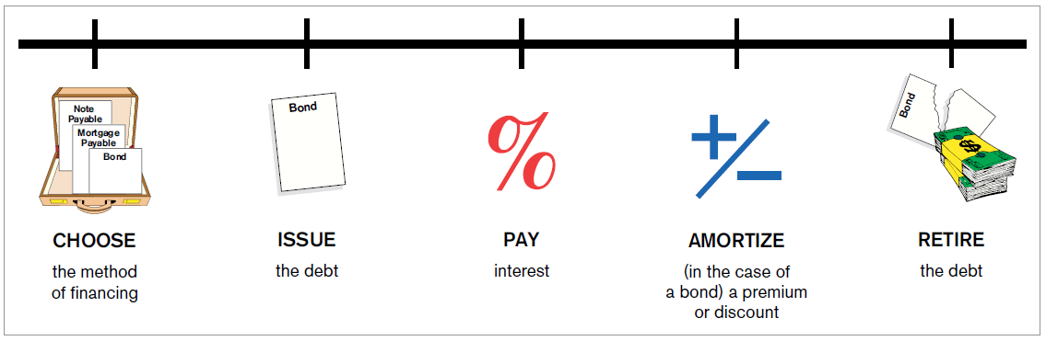
Accounting for Long-Term Liabilities
Accounting for Long-Term Liabilities
LO2
Business Issues Involved with Long-Term Liabilities
Exhibit 10.2

Slide 18
Accounting for Long-Term Liabilities
LO2
Types of Financing
Notes payable
Mortgages payable
Bonds

Slide 19
Interest-Bearing Notes
LO2
Illustration
Assume that on January 1, 2017, Giraffe Company borrowed $10,000 from City Bank for three years at 10% interest. Assume also that interest is payable annually on December 31.
Jan. 1,
2017
Cash
10,000
Notes Payable
10,000
Borrowed $10,000 from City Bank for three years.
Dec. 31,
2017
Interest Expense
1,000
Cash
1,000
Made first annual interest payment on City Bank note
($10,000 × 0.10).

Slide 20
Interest-Bearing Notes
LO2
Illustration
Dec. 31,
2018
Interest Expense
1,000
Cash
1,000
Made second annual interest payment on City Bank note
($10,000 × 0.10).
Dec. 31,
2019
Interest Expense
1,000
Notes Payable
10,000
Cash
11,000
Made final interest payment ($10,000 × 0.10) and repaid
principal on City Bank note.

Slide 21
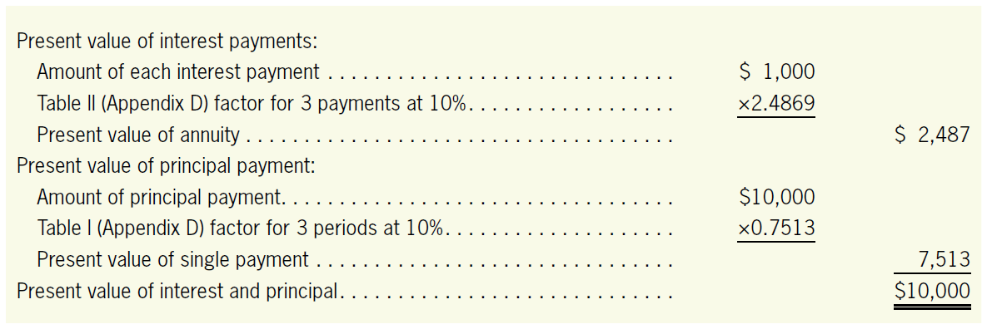
Interest-Bearing Notes
LO2
Illustration
The present value of the cash payments on the note is computed as follows:

Slide 22
Mortgages Payable
LO2
Mortgage money is usually related to a specific asset, typically real estate.
A mortgage amortization schedule identified how much of each mortgage payment is interest and how much is principal reduction
At the end of the year, a mortgage is reported on the balance sheet in two places:
The principal to be paid during the next year is shown as a current liability.
The balance of the mortgage payable is shown as a long-term liabilities
Notes:
22

Slide 23
Mortgages Payable
Illustration
Assume that McGiven Automobile Company borrows $100,000 on January 1 to purchase a new showroom and signs a mortgage agreement pledging the showroom as collateral on the loan.
Jan. 31
Cash
100,000
Mortgage Payable
100,000
Borrowed $100,000 to purchase the automobile showroom.

Slide 24
Mortgage Amortization
LO2
Illustration
If the mortgage is at 8% for 30 years, and the monthly payment is $733.76, payable on January 31 with subsequent payments due at the end of each month thereafter, the entries to record the acquisition of the mortgage and the first monthly payment are:
Jan. 31
Mortgage Payable
67.09
Interest Expense
666.67
Cash
733.76
Made first month’s mortgage payment.

Slide 25
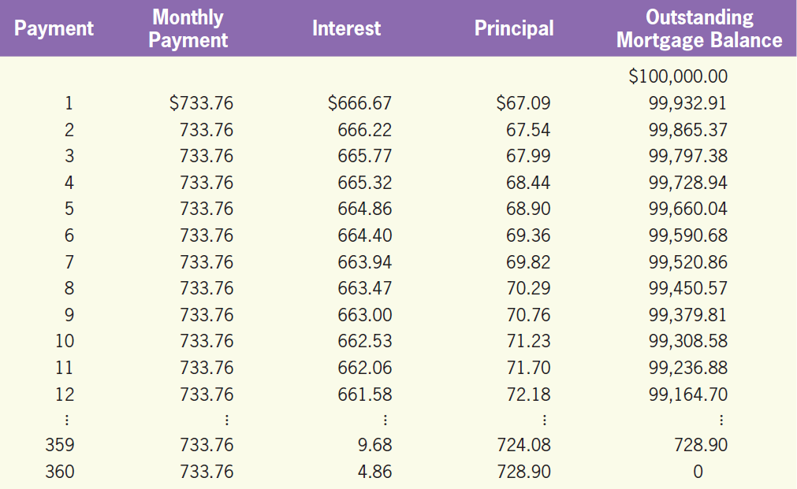
Mortgages Payable
LO2
Illustration
Part of each mortgage payment pays off interest due, and part of the payment reduces the principal amount due.
$100,000 × 8% × 1/12
Exhibit 10.3

Slide 26
Quiz Yourself
LO2
Compute the following:
The monthly payment on a $200,000 mortgage when $200,000 is borrowed for 20 years at 8% compounded monthly given that the present value factor of $1 for 240 periods is 119.5543
PV = $200,000; I = 0.08/12; N = 240
→ PMT = $1,672.88

Slide 27
Quiz Yourself
LO2
Compute the following:
The amount of the first payment (made one month after the mortgage is issued) that would be considered interest on the loan and the amount that would be applied to the principal
First payment of $1,672.88 would consist of $1,333.33 of interest and the balance ($339.55) applied to reduce the principal as follows:
$200,000 × 0.08/12 = $1,333.33 interest
$1,672.88 ‒ $1,333.33 = $339.55 as a reduction in principal

Slide 28
Bonds
The Nature of Bonds
LO3
A contract between the borrowing company (issuer) and the lender (investor).
The borrower promises to pay a specified amount of interest at the end of each period for which the bond is outstanding. The principal is then paid back at maturity.

Slide 29
Types of Bonds
LO3
The Extent to Which Bondholders are Protected
Debentures
Secured bonds
How the Bond Interest is Paid
Registered bonds
Coupon bonds

Slide 30
Types of Bonds
LO3
How the Bonds Mature
Term bonds
Serial bonds
Callable bonds
Convertible bonds
Others
Zero coupon bonds
Junk bonds

Slide 31
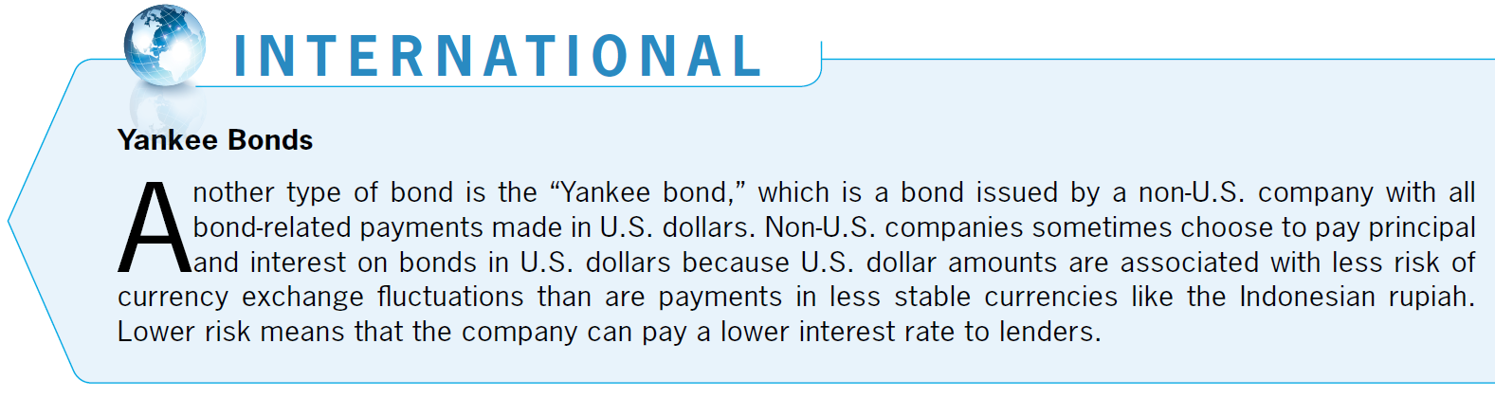
Types of Bonds
LO3

Slide 32
Characteristics of Bonds
LO3
Bond Indenture
A contract between a bond issuer and a bond purchaser that specifies the terms of a bond.
Principal (Face Value or Maturity Value)
The amount that will be repaid at the maturity date.
Usually issued in $1,000 increments.
Maturity Date
The date at which a bond principal or face amount becomes payable.

Slide 33
Characteristics of Bonds
LO3
Price of Bonds
The price of bonds is quoted as a percentage of face value.
A $1,000 bond quoted at 98 is selling for $980 (98% × $1,000).
A $1,000 bond quoted at 103 is selling for $1,030 (103% × $1,000).

Slide 34
Determining a Bond’s Issuance Price
LO3
Two Types of Payments When a Company Issuing Bonds
Payment of interest
A single payment—the principal

Slide 35
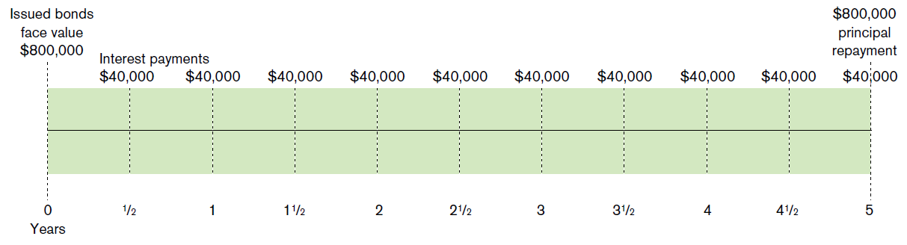
Determining a Bond’s Issuance Price
LO3
Illustration
Assume that Denver Company issues 10%, five-year bonds with a total face value of $800,000. Interest is to be paid semiannually.
$800,000 × 10% × ½

Slide 36
Determining a Bond’s Issuance Price
LO3
Stated Rate of Interest
The amount of interest the company promises to pay.
Market Rate of Interest (Effective Rate or Yield Rate)
What the market is paying for bonds of a similar nature.
Issuance Price
Present value of the interest payments
Present value of the bond’s face value at maturity
+
Using the market rate of interest

Slide 37
Determining a Bond’s Issuance Price
LO3
Bonds Issued at Face Value
When the effective rate is equal to the stated rate.
Bonds Issued at a Discount
When the effective rate is higher than the stated rate.
Bonds Issued at a Premium
When the effective rate is lower than the stated rate.

Slide 38
Determining a Bond’s Issuance Price
LO3
Four Steps to Computing Bond Values
Determine the market interest rate.
Compute the present value of the maturity amount.
Compute the present value of the annuity of annual interest payments.
Add the quantities computed in (2) and (3).

Slide 39
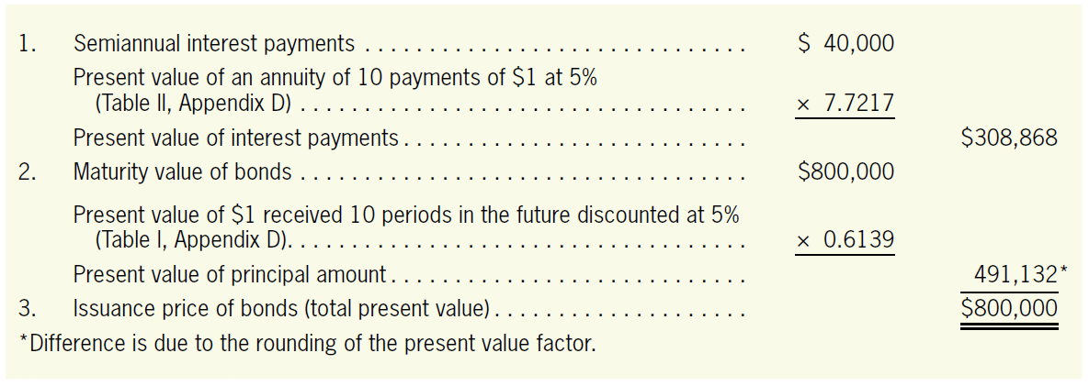
Determining a Bond’s Issuance Price
LO3
Bonds Issued at Face Value
Denver has agreed to issue $800,000 bonds and pay 10% interest, compounded semiannually.
Assume that the effective interest rate demanded by investors for bonds of this level of risk is also 10%.

Slide 40
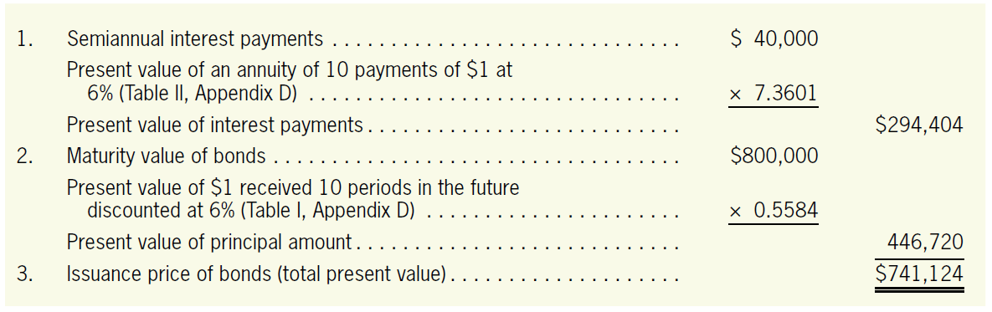
Determining a Bond’s Issuance Price
LO3
Bonds Issued at a Discount
Assume that the effective rate is 12% compounded semiannually; the stated rate remains 10% compounded semiannually.

Slide 41
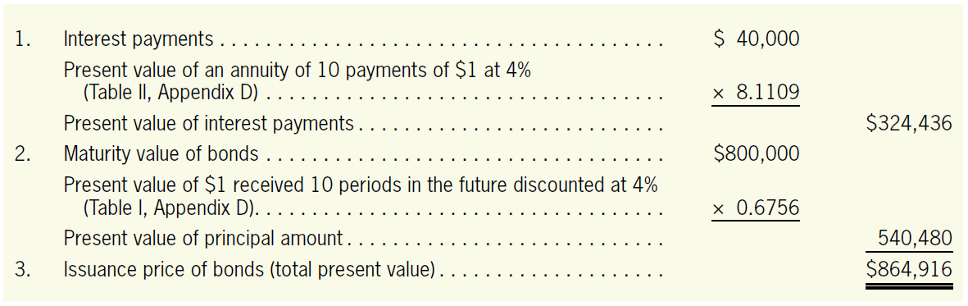
Determining a Bond’s Issuance Price
LO3
Bonds Issued at a Premium
Assume that the effective rate is 8% compounded semiannually and that the stated rate is still 10% compounded semiannually.

Slide 42
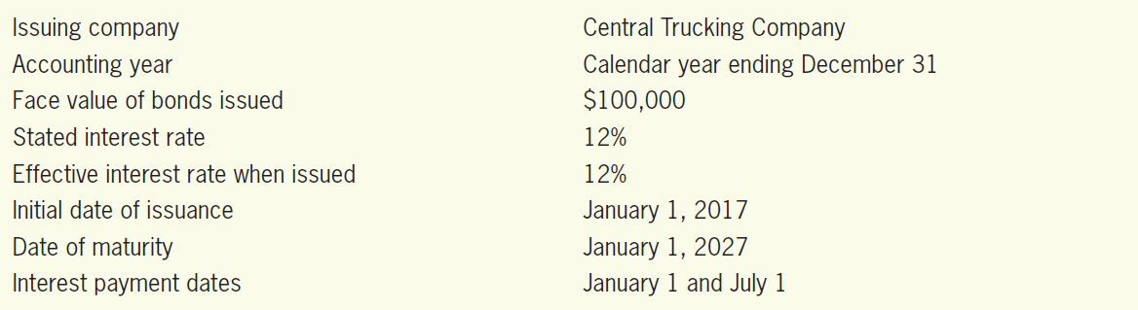
Bonds Payable Issued at Face Value
LO3
Illustration
For most of this discussion, we will use the following data:

Slide 43
Bonds Payable Issued at Face Value
LO3
Illustration
The journal entry to record their issuance on January 1, 2017, is as follows:
The entry to record the first semiannual payment of interest on July 1, 2017, is:
Cash
100,000
Bonds Payable
100,000
Issued $100,000, 12%, 10-year bonds at face value.
Bond Interest Expense
6,000
Cash
6,000
Paid semiannual interest on the $100,000, 12%, 10-year bonds ($100,000 × 0.12 × ½ year).

Slide 44
Bonds Payable Issued at Face Value
LO3
Illustration
The following adjusting entry on December 31, 2017, to account for the interest expense between July 1 and December 31, 2017:
Bond Interest Expense
6,000
Bond Interest Payable
6,000
To recognize expense for the six months July 1 to December 31, 2017 ($100,000 × 0.12 × ½ year).

Slide 45
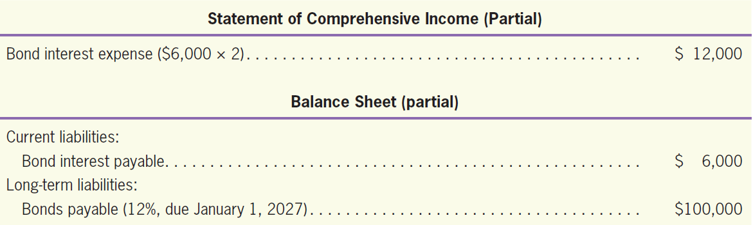
Bonds Payable Issued at Face Value
LO3
Illustration
At the end of the accounting period (December 31, 2017), the financial statements will report the following:

Slide 46
Bonds Payable Issued at Face Value
LO3
Illustration
On January 1, 2018, when the semiannual interest is paid, the bond interest payable account is eliminated. The January 1 entry is:
The entry required for retirement on January 1, 2027.
Bond Interest Payable
6,000
Cash
6,000
Paid semiannual bond interest.
Bonds Payable
100,000
Cash
100,000
Retired the $100,000, 10-year, 12% bonds.

Slide 47
Bonds Retirements before Maturity
LO3
Illustration
Assume that the Central Trucking bonds are now selling in the bond market at 109 and are callable at 110.
The company decides to take advantage of the lower interest rate (8%) by issuing new bonds and using the proceeds to pay off the outstanding bonds.

Slide 48
Bonds Retirements before Maturity
LO3
Illustration
Given that the bonds were issued at their face value, the penalty (the call premium) is $10,000.
The entry to record the retirement of the bonds at 110 is:
Bonds Payable
100,000
Loss on Bond Retirement
10,000
Cash ($100,000 × 1.10)
110,000
To retire $100,000 of bonds at a call price of 110.

Slide 49
Quiz Yourself
LO3
For each of the following, determine if the bond will be sold at face value, at a premium, or at a discount:
A bond with a stated interest rate of 6% is being sold when the market rate of interest is 8%.
The market rate is higher than the stated rate, so the company will have to sell the bonds at a discount.
A bond with a stated interest rate of 10% is being sold when the market rate of interest is 10%.
The market rate is equal to the stated rate, so the company will sell the bonds at face value.

Slide 50
Quiz Yourself
LO3
A bond with a stated interest rate of 8% is being sold when the market rate of interest is 6%.
The market rate is lower than the stated rate, so the company will be able to sell the bonds at a premium.

Slide 51
Debt-Related Financial Ratios
Using Debt-Related Financial Ratios
LO4
Debt Ratio
Represents the amount of assets financed through debt.
The debt ratio for Disney for 2015 is calculated as follows (the numbers are in millions):
Total liabilities
Debt ratio
=
Total assets
$39,527
Debt ratio =
= 44.8%
$88,182

Slide 52
Debt-Related Financial Ratios
LO4
Debt-to-Equity Ratio
The number of dollars of debt for every dollar invested by stockholders.
The higher the debt-to-equity ratio, the more debt the company has. The debt-to-equity ratio for Disney for 2015 is calculated as follows:
Total Liabilities
Debt-to-equity ratio =
Total Equity
$39,527
Debt-to-equity ratio =
= 0.81
$48,655

Slide 53
Debt-Related Financial Ratios
LO4
Times Interest Earned Ratio
The ratio of the income that is available for interest payments.
The higher the better.
Disney’s times interest earned ratio is computed as follows:
Income before interest and taxes (operating profit)
Times interest earned =
Annual interest expense
$13,171
$117
Times interest earned =
= 112.57 times

Slide 54
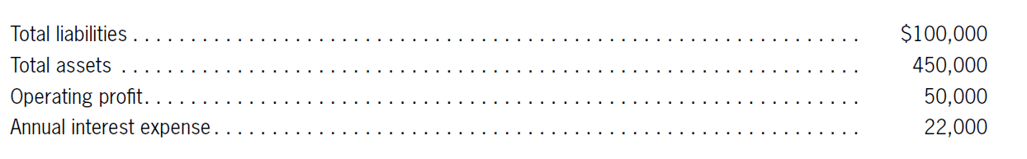
Quiz Yourself
LO4
Compute Berman Company’s debt ratio and times interest earned ratio given the following information:
Solution
Debt ratio = $100,000/$450,000 = 22.2%
Times interest earned = $50,000/$22,000 = 2.3 times

Slide 55
Amortizing Bond Discounts or Premiums*
Bonds Issued at a Discount or at a Premium
LO5
Straight-Line Amortization
Company writes off the same amount of discount or premium each period the bonds are held.
Effective-Interest Amortization
Company takes the time value of money into consideration.

Slide 56
Accounting for Bonds Issued at a Discount*
LO5
Illustration
Assume that the $100,000, 10-year, 12% bonds issued by Central Trucking on January 1, 2017, sold for $89,406 with the interest paid semiannually.
The market rate is 14%.
The entry to record the issuance of the bonds is:
Cash
89,406
Discount on Bonds Payable
10,594
Bonds Payable
100,000
Issued $100,000, 12%, 10-year bonds at $89,406.

Slide 57
Accounting for Bonds Issued at a Discount*
LO5
Illustration-Straight-Line Method
For Central Trucking, the semiannual amortization would be $530 ($10,594 discount/10 years × 1/2.)
Bond amortization is recorded when interest payments are made, so the entry on July 1, 2017, is:
Bond Interest Expense
6,530
Discount on Bonds Payable
530
Cash
6,000
Paid semiannual interest on the $100,000, 12%, 10-year bonds ($100,000 × 0.12 × ½ year) and amortized the bond discount ($10,594/10 years × ½ year).

Slide 58
Accounting for Bonds Issued at a Discount*
LO5
Illustration-Straight-Line Method
The adjusting entry to record the bond interest expense on December 31, 2017, is:
Bond Interest Expense
6,530
Discount on Bonds Payable
530
Bond Interest Payable
6,000
To recognize bond interest expense for the six months July 1 to December 31, 2017.

Slide 59
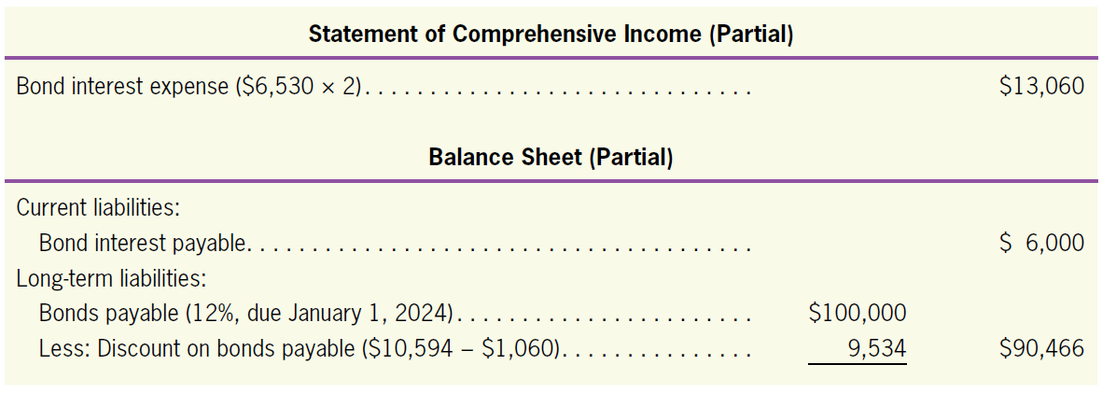
Accounting for Bonds Issued at a Discount*
LO5
Illustration-Straight-Line Method
The financial statements prepared at December 31, 2017, would report the following:

Slide 60
Accounting for Bonds Issued at a Discount*
LO5
Illustration-Straight-Line Method
That retirement entry is:
Bonds Payable
100,000
Cash
100,000
Retired the $100,000, 12%, 10-year bonds.

Slide 61
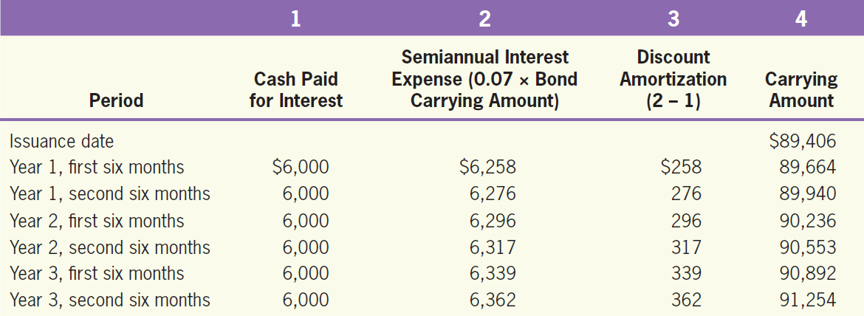
Accounting for Bonds Issued at a Discount*
LO5
Illustration-Effective-Interest Method
Assuming that in the example of Central Trucking, the effective interest rate is 14 % or 7% every six months.
7%

Slide 62
Accounting for Bonds Issued at a Discount*
LO5
Illustration-Effective-Interest Method
The entry on July 1, 2019 (Year 3) is:
The effective-interest method is required by generally accepted accounting principles (both IFRS and U.S. GAAP).
Bond Interest Expense
6,339
Discount on Bonds Payable
339
Cash
6,000
To record effective-interest expense on Central Trucking Company bonds for the first six months of year 3.

Slide 63
Accounting for Bonds Issued at a Premium*
LO5
Illustration
Assume that Central Trucking was able to sell its $100,000, 12%, 10-year bonds at 103.
The entry to record the issuance of these bonds on January 1, 2017, is:
Cash
103,000
Premium on Bonds Payable
3,000
Bonds Payable
100,000
Sold $100,000, 12%, 10-year bonds at 103.

Slide 64
Accounting for Bonds Issued at a Premium*
LO5
Illustration-Straight-Line Method
The entry to record the first semiannual interest payment and the premium amortization of July 1, 2017, is:
Bond Interest Expense
5,850
Premium on Bonds Payable
150
Cash
6,000
Paid semiannual interest on the $100,000, 12%, 10-year bonds ($100,000 × 0.12 × ½ year) and amortized the bond premium ($3,000/10 years × ½ ).

Slide 65
Accounting for Bonds Issued at a Premium*
LO5
Illustration-Straight-Line Method
The adjusting entry to record the accrual of the interest expense on December 31, 2017, is:
Bond Interest Expense
5,850
Premium on Bonds Payable
150
Bond Interest Payable
6,000
To recognize bond interest expense for the six months
July 1 to December 31, 2017.

Slide 66
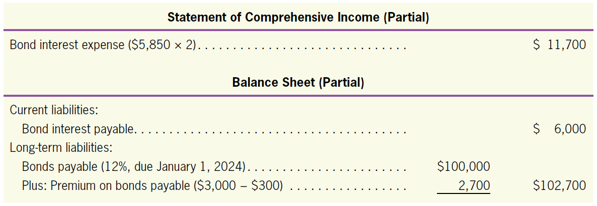
Accounting for Bonds Issued at a Premium*
LO5
Illustration-Straight-Line Method
The financial statements prepared at December 31, 2017, would report the following:

Slide 67
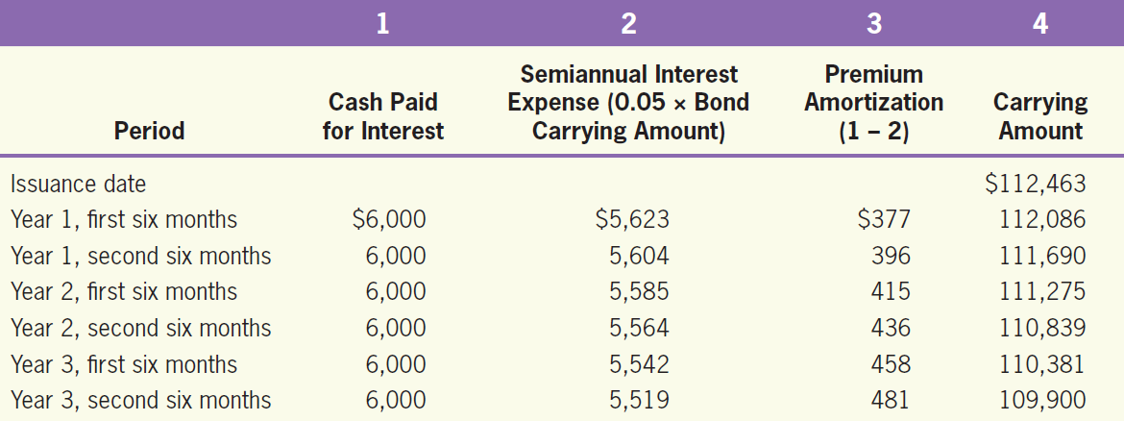
Accounting for Bonds Issued at a Premium*
LO5
Illustration-Effective-Interest Method
Assume that the Central Trucking $100,000, 12%, 10-year bonds were issued on January 1, 2017, for $112,463. The bonds pay interest semiannually on January 1 and July 1. The effective interest rate is 10 % or 5% every six months.

Slide 68
Accounting for Bonds Issued at a Premium*
LO5
Illustration-Effective-Interest Method
The entry on July 1, 2019 (Year 3) is:
Bond Interest Expense
5,542
Premium on Bonds Payable
458
Cash
6,000
To record effective-interest expense on Central Trucking Company bonds for the first six months of year 3.

Slide 69
Quiz Yourself
LO5
$100,000 of five-year, 10% bonds are issued for $103,000 on January 1, 2018. Interest payments on the bonds are made every six months.
Compute the total amount to be paid to bondholders over the life of the bond (face value + interest).
Subtract from (1) the proceeds from the sale of the bond to determine the total interest expense to be paid over the life of the bond issue.
Compute the average annual interest expense using the straight-line method.

Slide 70
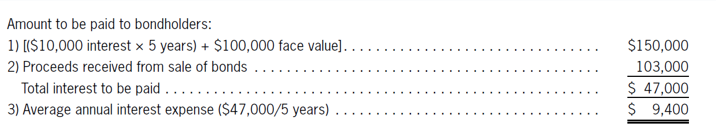
Quiz Yourself
LO5
Solution

